Slide 1
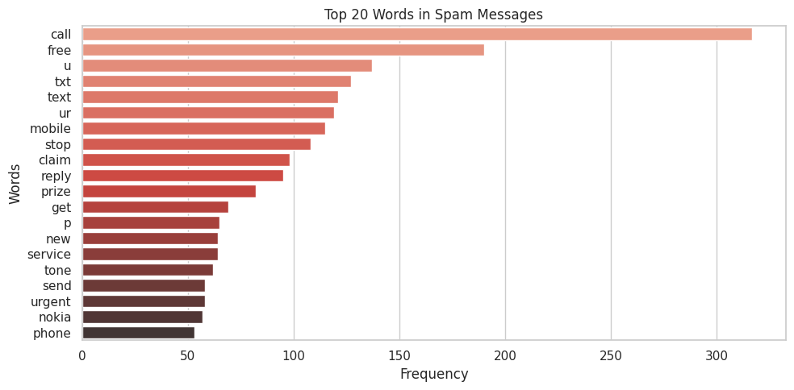
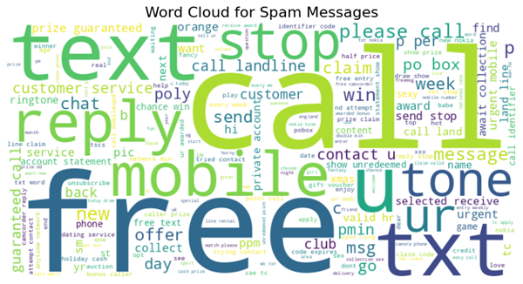
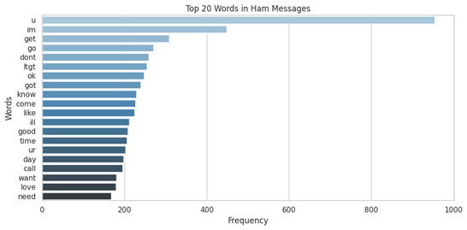
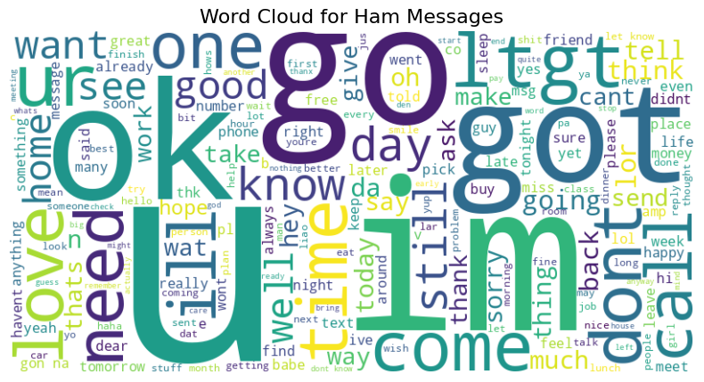
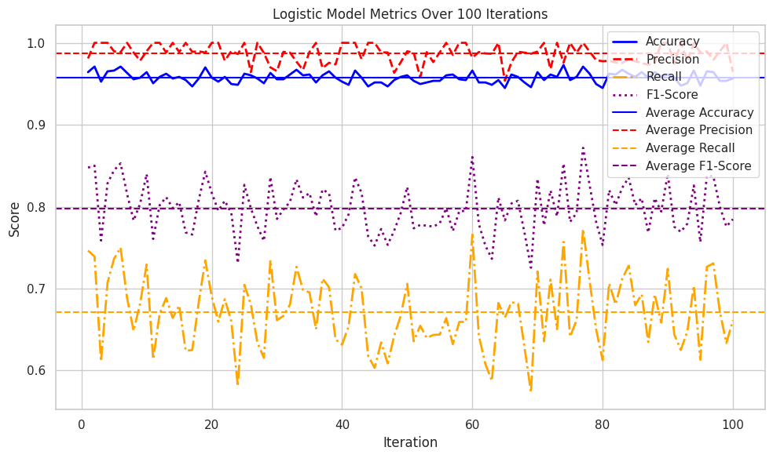
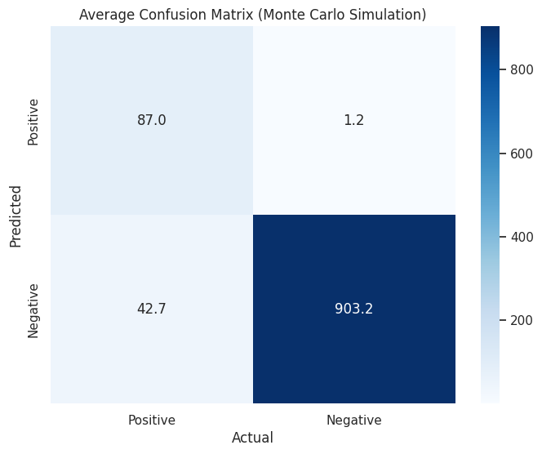
Department of Computing, Goldsmiths, University of London
Oluomachukwu Otuadinma,
ootua001@gold.ac.uk
Exploring NLP Techniques for Spam Detection: A Comparative Evaluation of Classifiers
Natural Language Processing (NLP) involves transforming written language (such as English) into a format that computers can process and understand. It has a wide range of applications, more specifically, it can filter out unsolicited messages by learning the patterns in emails linked to spam.
Preprocessing
Model Training & Evaluation
Raw Text Messages
Spam or Not Spam Prediction
Classification Output
I pre-processed a labelled dataset of SMS messages, extracted features using (Term frequency, Inverse Document Frequency) TF-IDF to calculate the importance of each word, and then trained four classifiers—Naive Bayes, SVM, Random Forest, and Logistic Regression—for comparative evaluation.
The above shows the results of TF-IDF, as I was able to find out the most commonly occurring words in both classes of messages. I visualised their occurrence using the word clouds
Then I ran each model I had prepared, Logistic Regression, Naive Bayes, SVM, and Random Forest and evaluated each ability to predict over 100 iterations, giving a greater understanding of the model’s accuracy across the data.

Slide 2
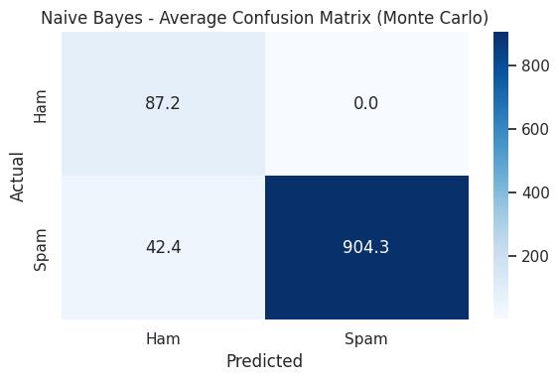
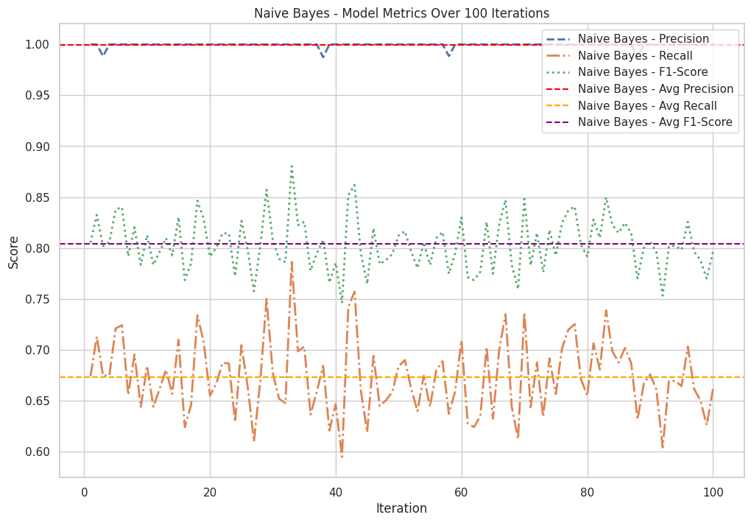
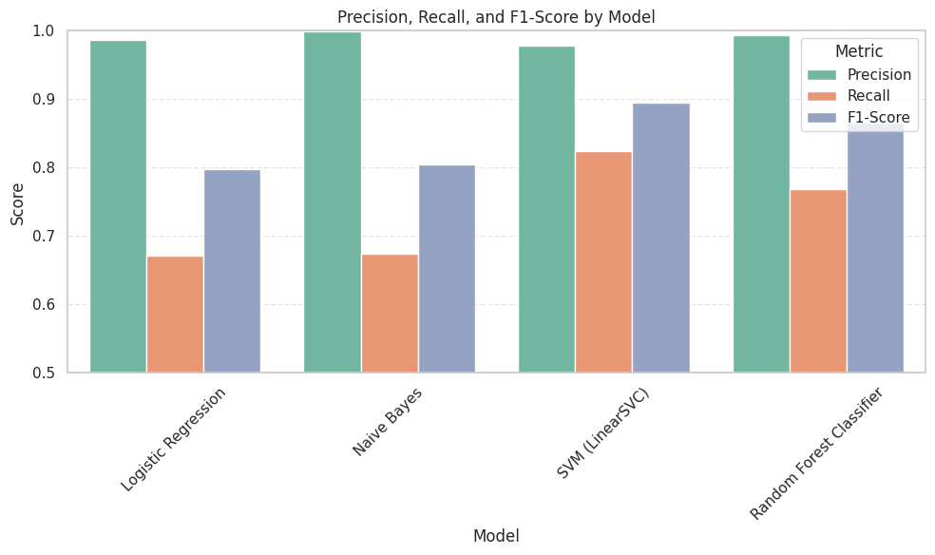
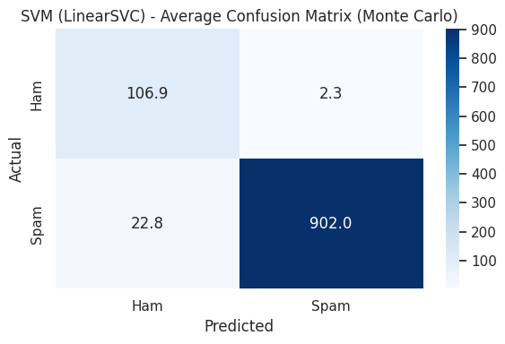
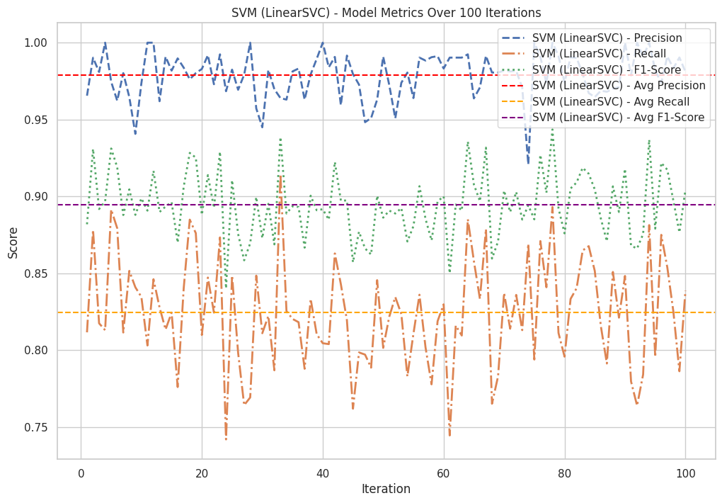
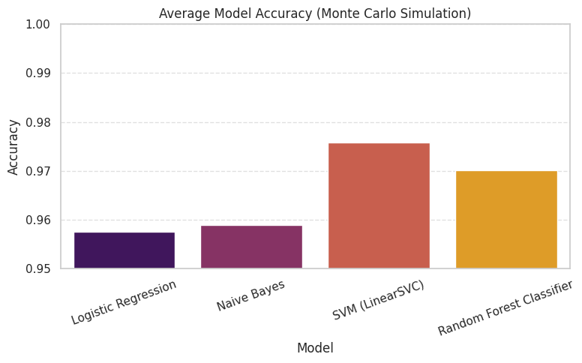
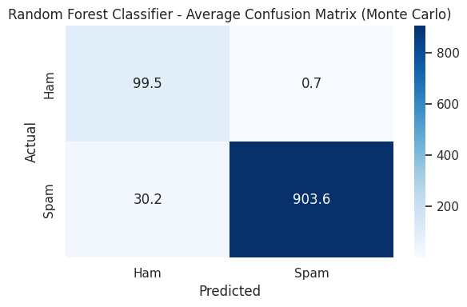
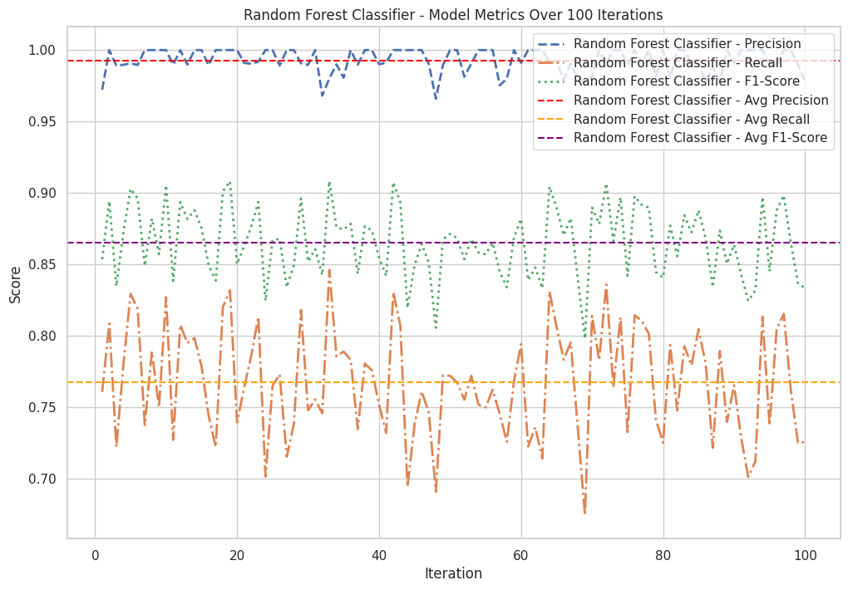
Logistic Regression had solid performance with high precision, and was effective at minimising false positives. However, its lower recall indicates it missed more actual spam messages compared to SVM and Random Forest, limiting its effectiveness for comprehensive spam detection. Naive Bayes overfitted with the data, meaning it stopped learning as it followed too closely to the training data. Random Forrest had a strong level of precision but wasn’t as accurate at predicting as SVM.
Key Findings: SVM stands out as the most reliable classifier for spam detection, offering the best balance between precision and recall, thus making it ideal for real-world NLP applications.

